Slide 1
The following slides outline the expected layout of a poster sized advertisement providing a template and an example.
This can be used in the following ways:
Posted on the ACAP website
Posted on official noticeboards (with permission)
Exporting Your Recruitment Material as an Image
Once you've finished editing your template slide in PowerPoint, you'll need to export it as an image file. Delete the "TEMPLATE" label from the corner before exporting.
In Microsoft PowerPoint (Mac or Windows):
Go to File → Export (Mac) or File → Save As (Windows). Under file format, choose PNG or JPEG. When prompted, select Current Slide Only (not "Every Slide"). This will save your slide as a high-resolution image you can print or upload directly to social media.
In Google Slides:
Go to File → Download → PNG image or JPEG image. This automatically downloads the current slide as an image.
Which format to choose:
Use PNG for the best quality, especially for printed posters or anywhere text sharpness matters. JPEG is fine for social media if file size is a concern, but PNG is preferred in most cases.
For printed posters:
Take the exported PNG to any printer and set for an A4 or A3 print. If you need a larger size than A3, let your supervisor know — the slide may need to be adjusted for higher resolution printing.

Slide 2


TEMPLATE
[STUDY TITLE HERE]
[One-line subtitle or call to action, e.g. “Share your experience in a 15-minute survey”]
ABOUT THIS STUDY
[Brief description of the study in plain, non-misleading language. Describe what participants will be asked to do.]
WHO CAN PARTICIPATE?
[Inclusion criteria, e.g. “Adults aged 18+ who have experienced...”]
[Exclusion criteria, e.g. “Individuals currently receiving...”]
TIME COMMITMENT
[e.g. “Approximately 15 minutes”]
CONTACT
[Supervisor Name]
[Researcher Name]
[researcher.email@mylearning.acap.edu.au]
QR
CODE
[Or visit: your-survey-link.com]
Scan to participate
This study has approval from the ACAP University College Human Research Ethics Committee (EC00447, Approval Number xxxx). For any concerns about the ethical conduct of this research, contact: hrec@navitas.com

Slide 3
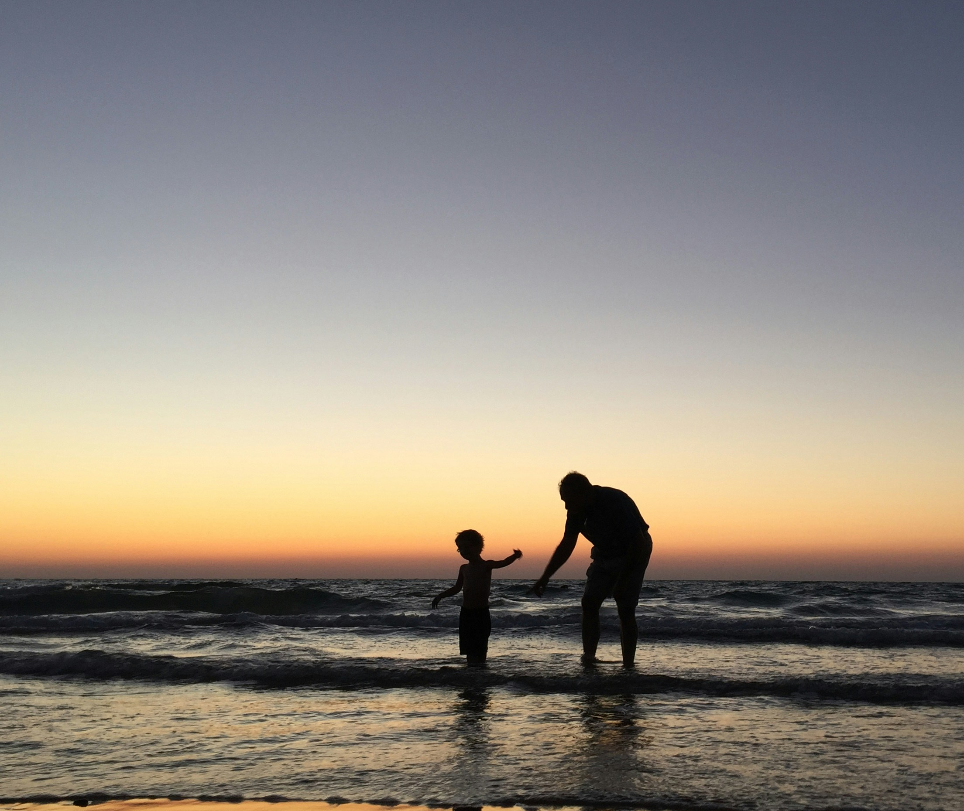

EXAMPLE
Are You a New
Parent?
Share your experience in a short online survey about postnatal well-being
ABOUT THIS STUDY
We are conducting research into the relationship between social support and postnatal wellbeing in first-time parents. Participation involves completing a confidential online questionnaire.
WHO CAN PARTICIPATE?
Adults aged 18 or older who have had their first child within the past 12 months. Participants must be currently residing in Australia.
TIME COMMITMENT
Approximately 20 minutes
CONTACT
Dr. Peter Parker (Supervisor)
Ms. Jane Smith (Student Researcher)
jane.smith@998798.acap.edu.au
QR
CODE
Or visit: bit.ly/postnatal-survey
Scan to participate
This research has been approved by the ACAP University College Human Research Ethics Committee (EC00447) (Approval Number S1234). For concerns about ethical aspects of this research, please contact the ACAP University College HREC: hrec@navitas.com
This study has approval from the ACAP University College Human Research Ethics Committee (EC00447, Approval Number xxxx). For any concerns about the ethical conduct of this research, contact: hrec@navitas.com

