Slide 1
The following slides outline the expected layout of a Meta (Facebook/Instagram) sized advertisement providing a template and an example.
This can be used in the following ways:
Posted on social media sites (include other required information in the text section of the post)
Exporting Your Recruitment Material as an Image
Once you've finished editing your template slide in PowerPoint, you'll need to export it as an image file. Delete the "TEMPLATE" label from the corner before exporting.
In Microsoft PowerPoint (Mac or Windows):
Go to File → Export (Mac) or File → Save As (Windows). Under file format, choose PNG or JPEG. When prompted, select Current Slide Only (not "Every Slide"). This will save your slide as a high-resolution image you can print or upload directly to social media.
In Google Slides:
Go to File → Download → PNG image or JPEG image. This automatically downloads the current slide as an image.
Which format to choose:
Use PNG for the best quality, especially for printed posters or anywhere text sharpness matters. JPEG is fine for social media if file size is a concern, but PNG is preferred in most cases.
For Meta (Facebook/Instagram) posts:
Upload the exported PNG directly as your post image. The Meta template is already sized to the recommended 4:5 (1080×1350) for feed posts.

Slide 2


[YOUR STUDY TITLE HERE]
TEMPLATE
Add image on blue space
This study has approval from the ACAP University College Human Research Ethics Committee (EC00447, Approval Number xxxx). For any concerns about the ethical conduct of this research, contact: hrec@navitas.com

Slide 3
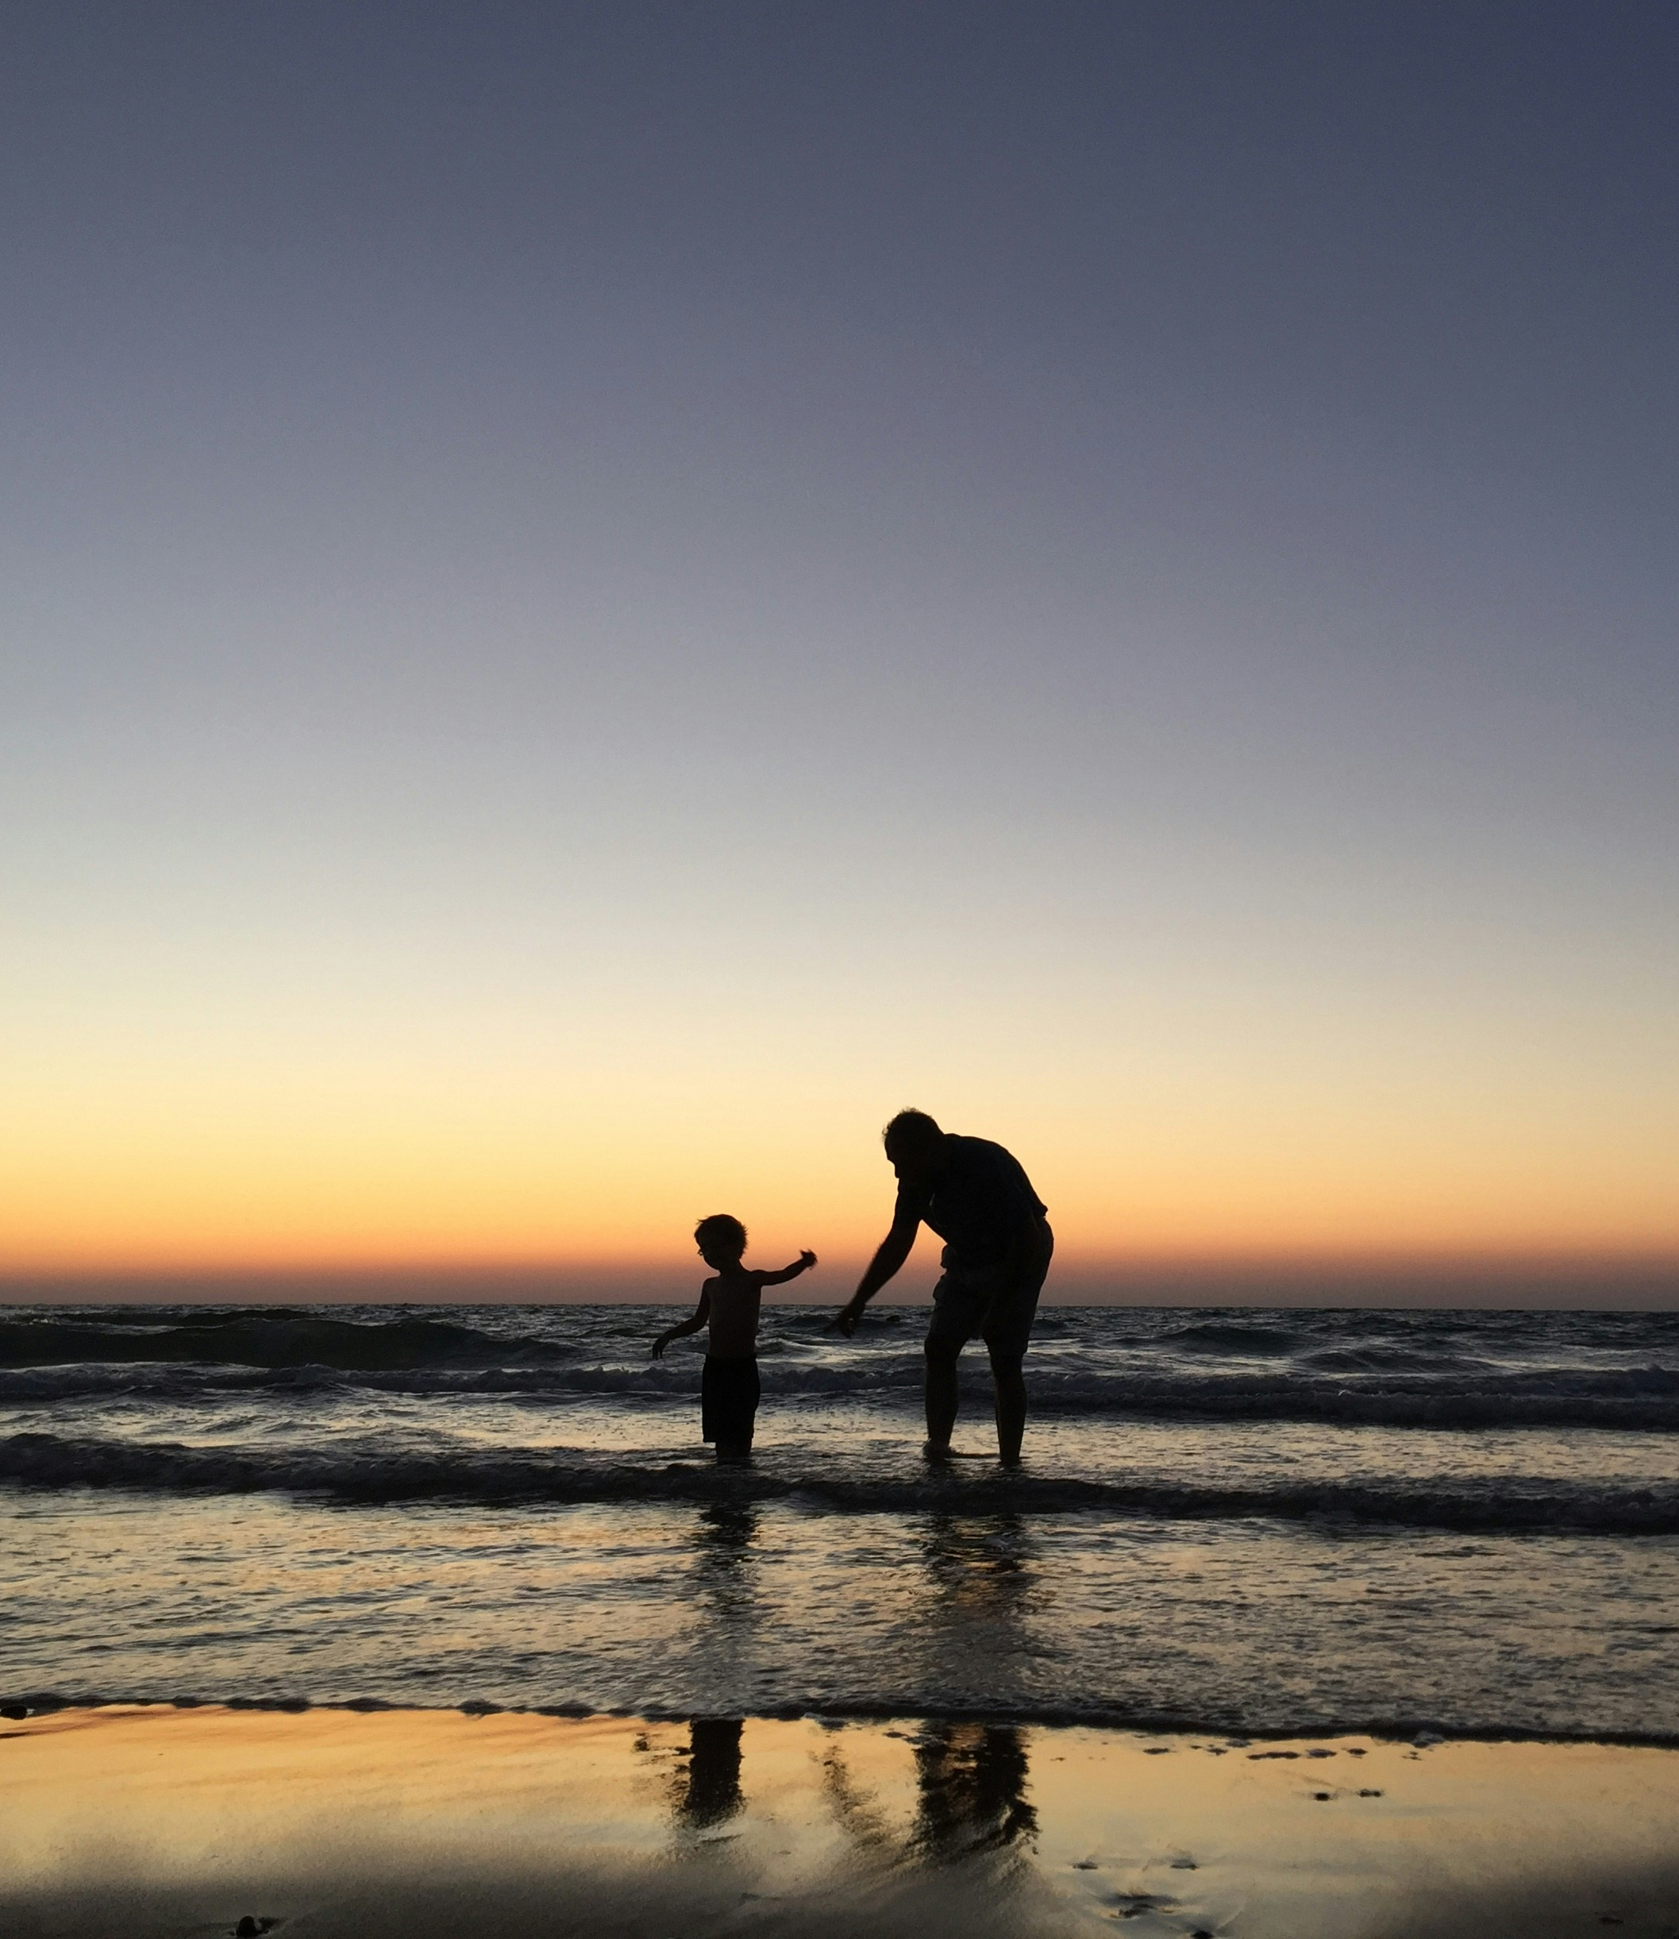

EXAMPLE
Are You a New Parent?
Share Your Experience
This study has approval from the ACAP University College Human Research Ethics Committee (EC00447, Approval Number xxxx). For any concerns about the ethical conduct of this research, contact: hrec@navitas.com

Slide 4
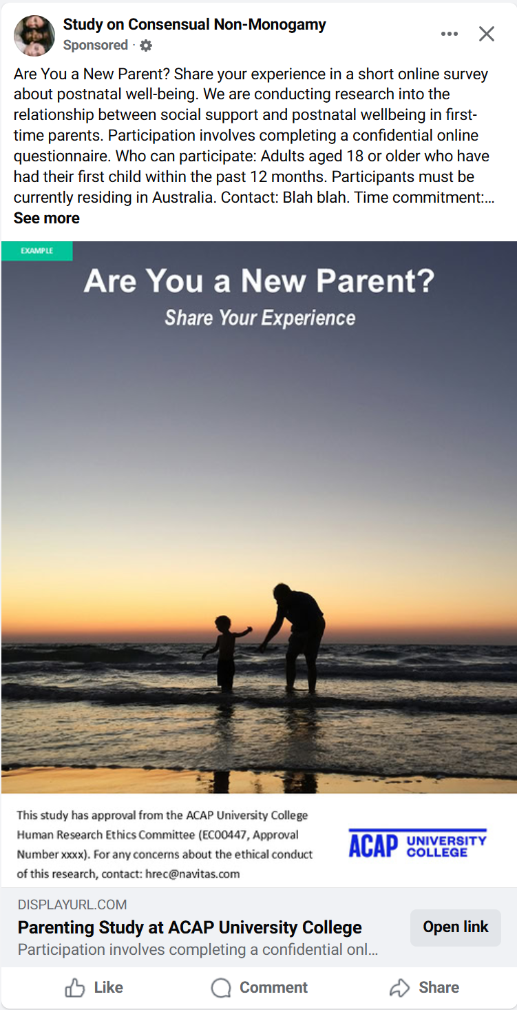
Example Mock-up - Desktop
Parenting Study

Slide 5
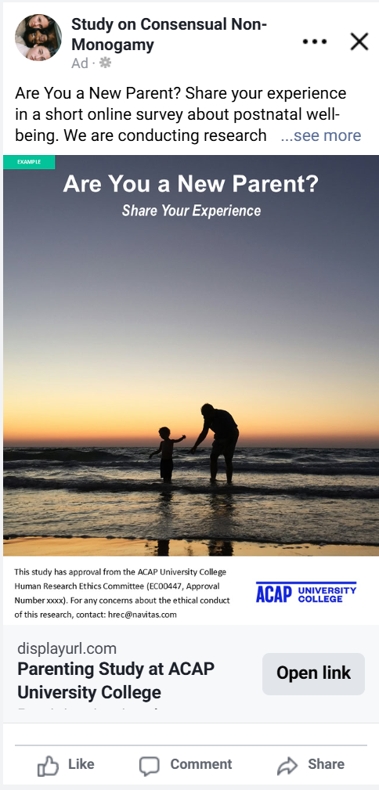

Mock-up: Mobile

